Slide 1

Analyzing Amazon Sales Data

Slide 2
INTRODUCTION
The project revolves around conducting an in-depth analysis of sales data from Amazon, one of the world's largest e-commerce platforms. Through advanced analytics techniques, we aim to extract valuable insights from the dataset to better understand sales performance across different regions, product categories, and sales channels.
By descriptive, diagnostic, predictive, and prescriptive analytics, we will uncover patterns, trends, and relationships within the data.

Slide 3
PROJECT ANALYSIS
Project analysis is the most important to unlock resources and key factor from the data and improve the performance of Amazon sales data.
We are using power bi tool for finding solutions for Analyzing Amazon sales data

Slide 4
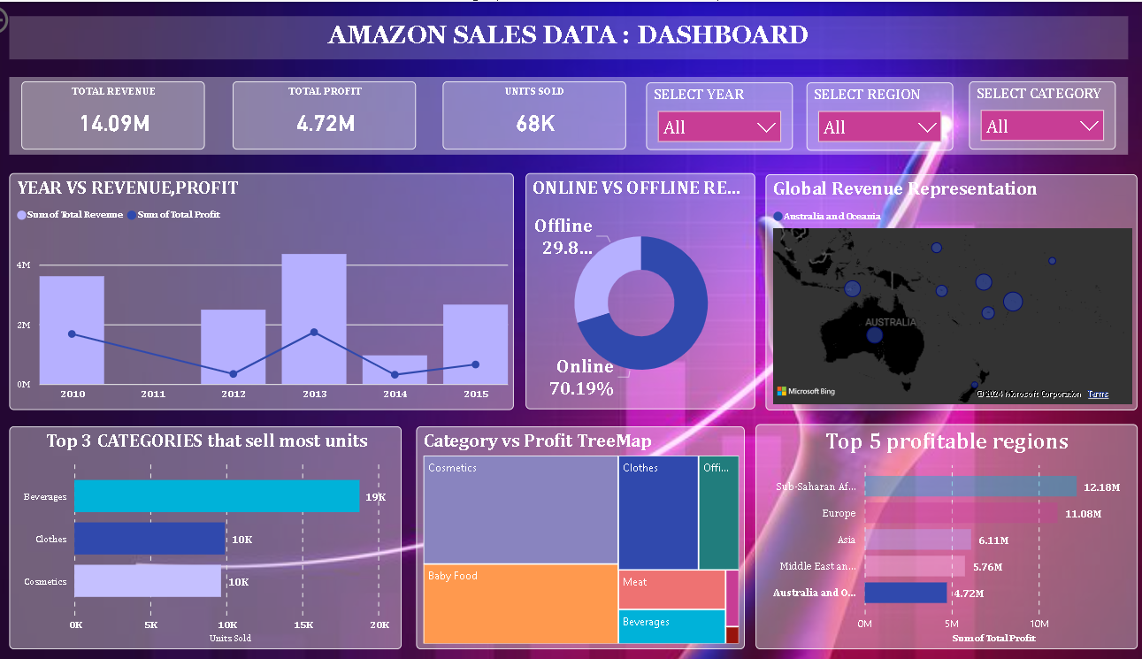
DASHBOARD

Slide 5
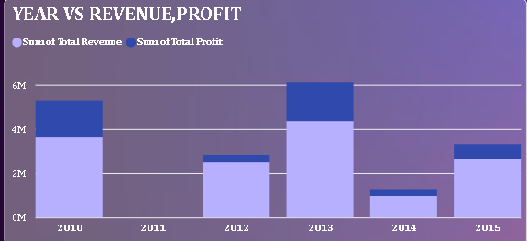
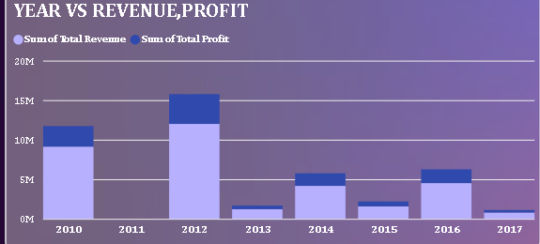
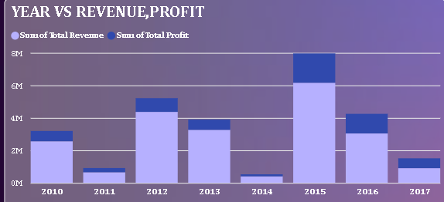
OBSERVATIONS
YEAR VS. REVENUE PROFIT
AUSTRALIA
EUROPE
ASIA

Slide 6


